Slide 1

Suffolk Constabulary
Chief Constable’s proposals for increase in policing element of council tax 2023/24.

Slide 2
CCR investment
Introduction and contents
Introduction.
This document has been prepared for the Police and Crime Panel on 27 January 2023, and sets out the Chief Constable’s proposals for additional money from the Policing element of the council tax in 2023 and beyond.
Contents
An overview of the recent PEEL inspection of Suffolk Constabulary by His Majesty’s Inspectorate of Constabulary and Fire and Rescue .
This shows that HMIC assess the Constabulary as both good and improving however, states that improvement is required in relation to
‘supporting victims’ and in particular the service it provides to enable the public to contact, transact and engage with Suffolk Constabulary.
The Chief Constable’s proposal to create a Digital Contact and Engagement desk.
This will ensure the Constabulary responds to societal changes and the growth and expansion in digitalisation and social media. It will
provide the opportunity for the public to contact, transact and engage with Suffolk Police using technology now used as part of day to day life.
The Chief Constable’s proposal to enable a rapid video response to domestic abuse incidents across Suffolk.
Technology is available (and already used in some UK Police Forces) to enable the Police to respond to calls from victims of
domestic abuse by video link to enable them to rapidly assess and investigate the matter.

Slide 3
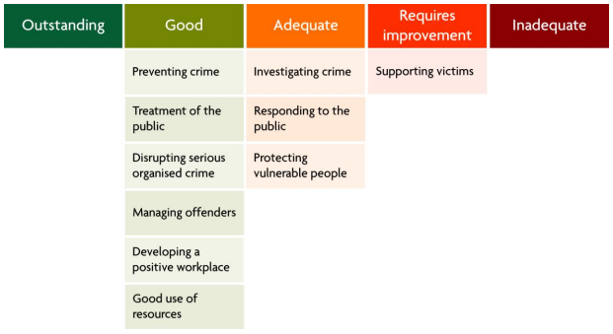
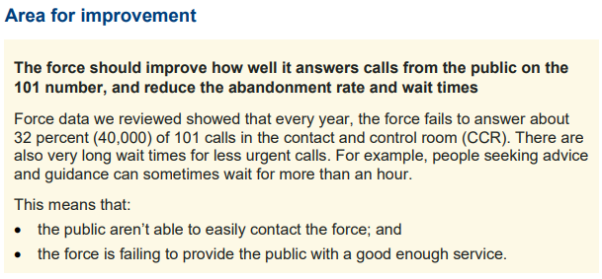



Context
Continued investment in public contact for improved performance and productivity
“Suffolk Constabulary must continue to invest in our public contact capabilities in order to effectively meet demand and provide a service that adequately supports our victims.” ( MICFRS PEEL Inspection of Suffolk 2022)
“Improving the responsiveness of local police to 101 and 999 calls”

Slide 4


CCR investment
Digital Contact and Engagement desk.
A 24/7 Digital Contact and Engagement Desk would mean:
Resourcing requirements
= £588,120 *2 x Band F (supervisors) and 12 x Band E (operators)
Enabling technology
= £36,144 to upgrade and replace existing technology
Performance and productivity benefits
Improved contact experience/options for service users and wider community to contact Suffolk Constabulary via the digital and social media channels they feel most comfortable with and use as part of their everyday life. Technological advancements provide additional ways of contact, and the Constabulary , like many other organisations, need to maximise these opportunities to continue to be effective and efficient and provide greater choice to the public to achieve the level of service expected.
Better two-way engagement across all demographic groups.
Reduced demand on call handlers.

Slide 5
CCR investment
Rapid Video Response (RVR)
“In domestic abuse cases, a rapid video connection leads to higher victim satisfaction.” The Police Foundation, 2022.
With the rapidly increasing volume of demand reaching police control rooms, and the growing complexity of the calls they receive, innovative solutions are needed if we are to manage that demand as effectively as possible for both the force and for our service users. This is particularly the case for vulnerable people making contact during or immediately after domestic abuse incidents who require tailored support and safeguarding.
Forces that have already adopted RVR have reported increased levels of victim satisfaction and engagement with the Police.
Rapid Video Response would mean:
  ‘First response’ from a trained officer is faster and can be more convenient.
  Dynamic assessment of severity of incidents and therefore safeguarding needs.
  Early evidence capture and victim statements.
Resourcing requirements
= £586,670 * 5 officers (PCs), 2 Sgt, PM (Band G), 2 dispatchers (Band D), 1 analyst (Band E)
Better engagement with vulnerable victims, leading to greater likelihood of supporting prosecution.
Better allocation of resources to meet the specific needs of domestic abuse victims.
Higher satisfaction levels among domestic abuse victims using the RVR solution.
Enabling technology
= £35,000

